Slide 1
CPT 203
Revision on week 1-4

Slide 2
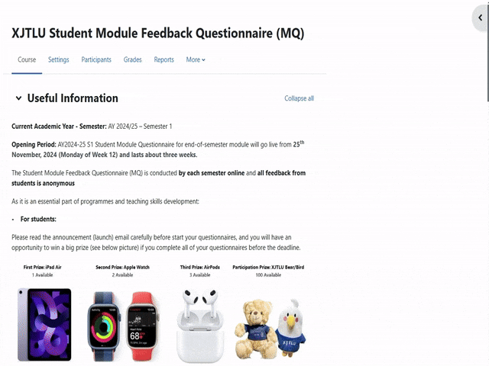
XJTLU Student Module Feedback Questionnaire
https://core.xjtlu.edu.cn/course/view.php?id=1677

Slide 3
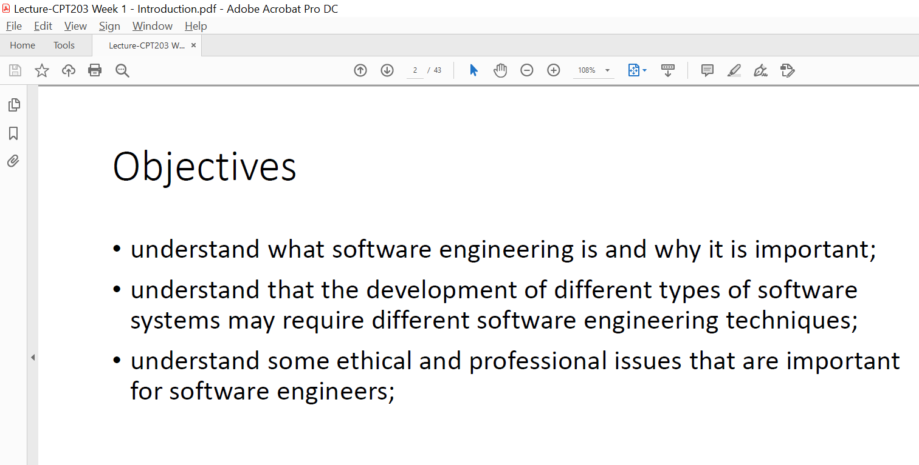
Week 1 -1
Lecture page 2

Slide 4
Week1 -2
What is software engineering ?
The activities of software engineering
Software engineering approaches
What is professional software development ?
Software engineering ethics
Software deterioration

Slide 5
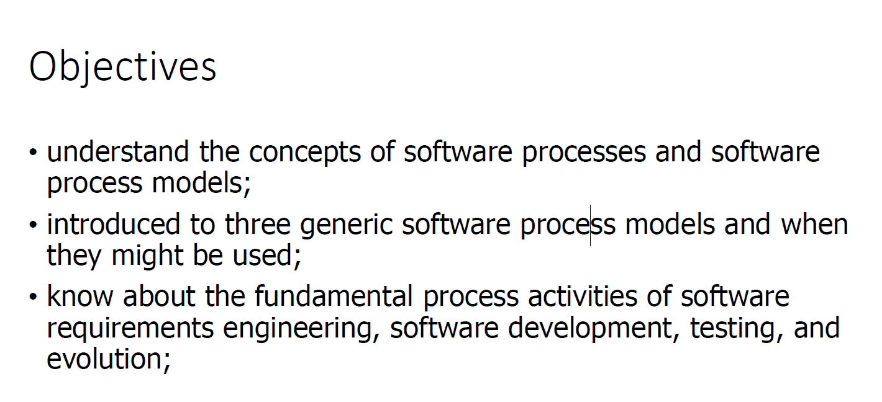
Week 2 -1
Lecture page 2

Slide 6
Week 2 -2
What are the software process activities ?
Definition of each of them
What are the software process models? Able to explain them
Their characteristics, advantages and disadvantages
Given a scenario, how to decide which process model to use? Able to provide justification

Slide 7
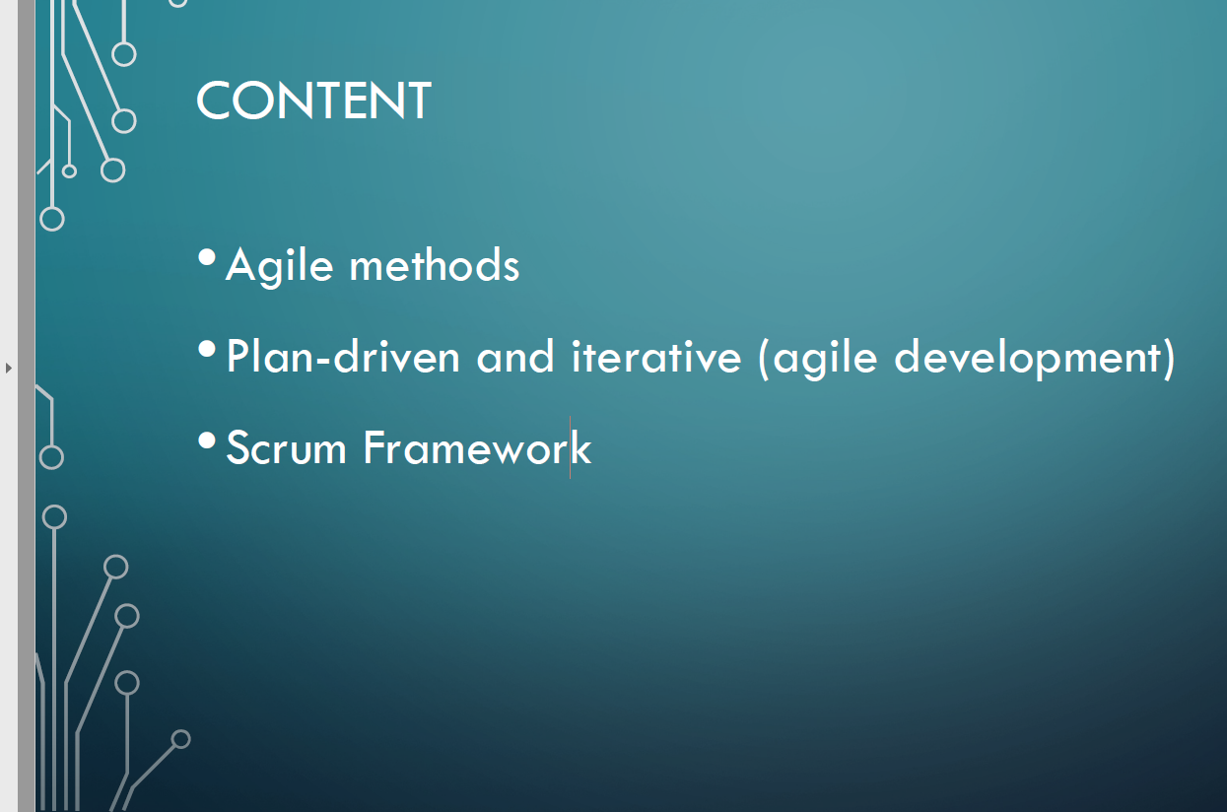
Week 3-1
Page 2

Slide 8
Week 3 -2 Agile
Principles of agile methods
Characteristics, advantages and disadvantages of agile methods
Given a scenario, able to decide if agile is a good choice
Comparison on agile and plan-driven
Scrum framework (roles, activities, and artifacts)

Slide 9
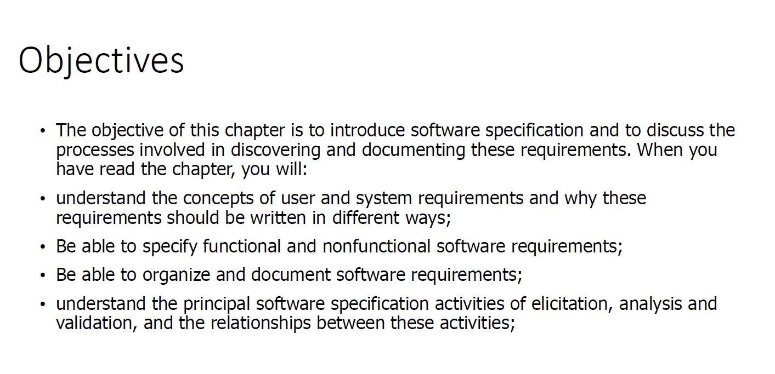
Week 4 Software Specification -1

Slide 10
Week 4 Software Specification -2
Software specification processes
system requirements and user requirements:
definition,
to differentiate them, and to compare
able to provide examples
Techniques to define system requirements
functional and non-functional requirements

Slide 11
Week 4 Software Specification -3
emergent system
How to do requirements elicitation and analysis? Able to work on use cases
What is software requirements document? Good practices of making such a document, and level of details
What are requirements validation? What activities might include ? And their techniques ?

Slide 12


